Slide 1
No Instruction Computing Using Pointers and Operations in Registers for Adaptable Architecture IXPUG Annual Meeting 2020
Dr. Nagi Mekhiel
Department of Electrical, Computer and Biomedical Engineering
Ryerson University, Toronto, CANADA
nmekhiel@ee.ryerson.ca

Slide 2
Introduction
Current architectures depend on delivering maximum numbers of instructions per cycle
Performance more dependent on memory bandwidth
Must use program counter each cycle to fetch instructions from memory
Issuing parallel instructions is complicated
Operations have more localities than data and could move to registers

Slide 3
No Instructions Computing Concept
It uses load to transfer operations and operands from memory to the register file
It eliminates the use of a program counter that points only to one instruction at a time
Single operation register pointer stores multiple pointers each points to one operation in another lower level registers
The last field of register pointer points to the next operation register that loads the next block of code to be executed
It executes multiple operations in parallel if the mode in operation pointer indicates a parallel operation

Slide 4
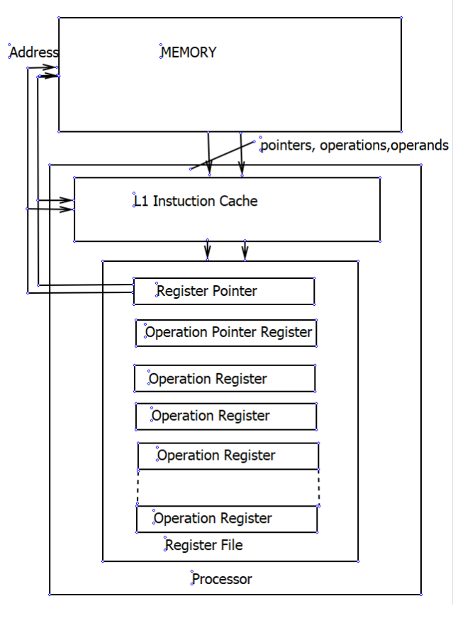
The Concept and Organization

Slide 5
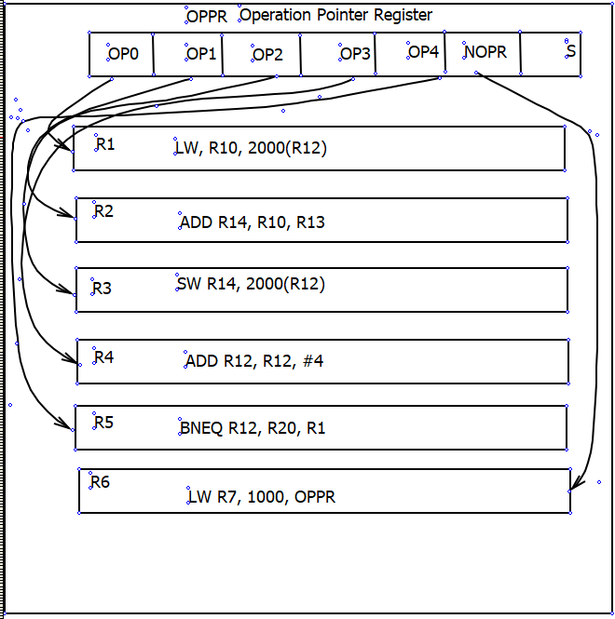
Example of an application
for(i=0; i<N;i++){A[i]=A[i]+B;}.

Slide 6
Performance Evaluation
for(i=0; i<N;i++){A[i]=A[i]+B;}. Register access=1 cycle, Memory access = 2 cycle
Conventional Architecture
Total time = 5Nx1 cycle for executing instructions + 2Nx2 cycles for data + 5Nx2 cycle for instructions memory= 19N cycles
Memory BW requirements = (2N+5N)x4B/19N= 1.5B/cycle
No Instructions Computing
Total time= 5Nx1 cycle for executing instructions + 6x2 cycles to load the pointer and operations + 2Nx2 cycles for data load and store= (9N + 12) cycles
Memory BW requirements= 2Nx4B/(9N+12) = .89 B/cycle
Gain:
Performance gain= 19N/(9N+12) = about 200% and Memory BW reduction = 1.5B/.89 B= 168 %

Slide 7
Conclusions
No Instructions Computing eliminates the use of program counter and reduces memory bandwidth requirements
It is adaptable and supports SIMD and parallel operations Parallel operations from a single operation register pointer eliminates the overhead of synchronization
Future work needs to implement it using suitable technology like FPGA and develop software tools to run actual applications
References
1-Nagi Mekhiel, Instructions with Indirect Register Indexing for Multiple and Exponential Operations to Improve Performance?, The 12thIEEE International Conference on Computer Engineering and Systems (ICCES 2018), Dec 18-19 2018, Cairo, Egypt
2-Nagi Mekhiel, Take the ‘No Instruction’ road past memory straits, EE Times Aug 23, 1999

